Slide 1






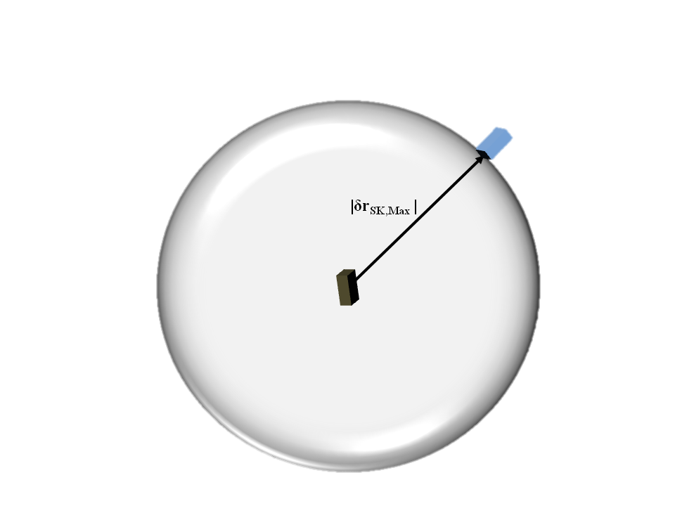
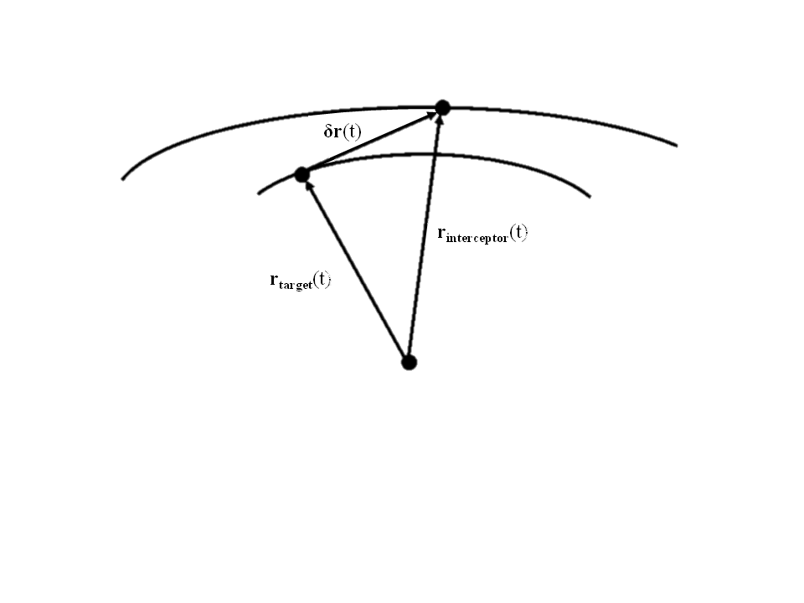
Rascal
Demonstration of Proximity Operations & Rendezvous in University-Class Spacecraft
Senior Team Members: Jennifer Babb, Bryant Gaume, Tom Moline, Tyler Olson, Nate Richard
Acknowledgements: Michael Swartwout Ph. D., Kyle Mitchell Ph. D.
Mission Statement
Demonstrate the performance of Rendezvous and Proximity Operations (RPO) and the inspection of a cooperating Resident Space Object (RSO) within a small spacecraft architecture.
Functional Block Diagram
Mission Relevance
Primary Spacecraft
NASA Strategic Goal 3.3: Develop and demonstrate the critical technologies that will make NASA’s exploration, science, and discovery missions more affordable and more capable.
Useful RPO Mission Data: Provide more insight into the capabilities of small spacecraft in performing RPO missions.
Secondary Spacecraft
Flash Memory
Primary Aids
PLD
PWR
Imager
CDH
Regulators
Batteries
Contact Switch
CDH
ADC
Thruster Block
PRP
Mission Risks
Microcontroller
Nutation Dampening
Firing Circuit
Spacecraft unable to separate
Collision during inspection stationkeeping
Unable to rendezvous during cooperative maneuvers
Unable to rendezvous during non-cooperative maneuvers
Collision during rendezvous
5
4
3
2 |  |  |  | 2, 3, 4 | 5
1 |  |  |  |  | 1
 | 1 | 2 | 3 | 4 | 5
COM
SEP
Primary Attachment
SEP
RFID Chip
Solenoid
Secondary Attachment
Power Pass
Patch Rx Antenna
Boeing
SSRL Ground Station
Concept of Operations
Mission Definitions
Mission Information
Inspection Distance Checkout
Inspection: resolving individual components on the external surface of a resident space object.
Inspection Stationkeeping: maintaining a constant distance (<10 m) relative to a resident space object.
Remote Stationkeeping: maintaining a constant distance (>100 m) relative to a resident space object.
Rendezvous: decreasing the relative distance to a resident space object.
Architecture: Two, 3U (10 x 10 x 30cm) CubeSats (One Primary, One Secondary)
Mission Lifetime: Two Weeks for Secondary Spacecraft, 6 Months for Primary Spacecraft.
Propulsion: Cold-gas, 50 m/s of ∆V.
Imaging: 30 fps, 640x480 pixel, visual spectrum camera.
Controls: Defined through linear orbit theory and CW coordinate frame
Orient for Separation
LV Separation and Checkout
Separation
Move to maximum relative separation
Launch
Stationkeep at maximum relative distance
Extended Ops and Deorbit
Repeat mission without visual aids
Inspection
Rendezvous
Developed in Partnership with the Boeing Company’s Advanced Space & Intelligence Systems Organization

